Slide 1
Predictive Analytics
for Road Safety
PORTO BUSINESS SCHOOL · EMBAAI · PREDICTIVE ANALYTICS & FORECASTING
Golden Hour triage: which crash needs Advanced Life Support?
Group 6 · Joao · Olena · Samuel · Nuno · Pedro
Presentation 20 Oct 2026 · Submission 27 Oct 2026

Slide 2
Agenda — 10 minutes
01
Problem definition
~1.5 min
02
Data understanding
~2 min
03
Data preparation
~1.5 min
04
Predictive modelling & results
~3 min
05
Conclusions, limitations & future work
~1.5 min
06
Annexes (on request only)
—
Road Safety Predictive Analytics — Group 6
02

Slide 3
A road-safety authority, learning from the past
THE BRIEF
A national road-safety authority wants to use historical accident data to support better decisions
Our group acts as its analytics team
The prediction task is intentionally not given to us — we define it ourselves (Task 1)
150,000
highway accidents, Brazil, 2007–2025
23
variables per accident — date, location, road infrastructure, severity
Road Safety Predictive Analytics — Group 6
03

Slide 4
Problem definition
01
Task 1 — 10% of the grade. Start from the decision, not the dataset.

Slide 5
Our problem passes the five gates
01 · PROBLEM DEFINITION
Gate | Does our chosen problem pass?
Repeated decision | Yes — every emergency call: standard patrol / basic ambulance, or an ALS unit / helicopter?
Actionable score | Yes — the dispatcher sends ALS to the 15% of calls with the highest predicted fatality risk
Past outcomes | Yes — 150,000 labelled accidents, 7,222 fatal (4.8%): enough positives, but heavily imbalanced
Stable world | Partly — reporting changed in 2015 (e-DAT): logged fatal share 3.8% → 7.0%; we split by time and re-calibrate
Positive balance | Yes — ALS dispatch ≈ €2,500 vs. ≈ €50,000 per prevented death: worth it above 5% risk (p*)
Road Safety Predictive Analytics — Group 6
05

Slide 6
Candidate problem framings
01 · PROBLEM DEFINITION
Framing | Target | Type | Decision it supports
Severity prediction | No injuries / injuries / fatalities, per accident | 3-class classification | Prioritise enforcement & infrastructure fixes
Severe-accident hotspots | Share of injury or fatal accidents per highway-km stretch & period | Regression / ranking | Where to invest in infrastructure first
Fatality risk given accident ✓ our choice | Probability an accident, once it happens, is fatal | Binary classification | Emergency response prioritisation
The data holds only accidents — we can predict how severe an accident is, not whether one will happen.
Road Safety Predictive Analytics — Group 6
06

Slide 7
Our chosen problem: Golden Hour triage
01 · PROBLEM DEFINITION
Business question
Which crashes need Advanced Life Support (ALS) within the Golden Hour?
Decision supported
At the emergency call, the dispatcher sends ALS / helicopter or a standard patrol
Target definition
is_fatal = 1 when accident_classification = 2 · 4.8% overall, 7.1% in 2024–25
Unit of analysis
One collision · all federal highway crashes
Prediction horizon
Real time, at call intake (t=0): only road, location and time are known
Road Safety Predictive Analytics — Group 6
07

Slide 8
Metrics: why 93% accuracy is a trap
01 · PROBLEM DEFINITION
Accuracy (rejected)
“No fatality, ever” scores 92.9% on 2024–25 and catches 0% of deaths
PR-AUC
Ranking quality on a rare event — random scores 0.071 on the test set
Recall & lift @ top 15%
ALS can serve 15% of calls: share of fatal crashes in that slice, vs. random
Brier score
Are the predicted probabilities trustworthy? Lower is better
Threshold p* = 5%
€2,500 ALS cost ÷ €50,000 benefit · test base rate 7.1% > p*, so capacity binds
Road Safety Predictive Analytics — Group 6
08

Slide 9
Data understanding
02
Task 2 — 15% of the grade. Know your data before you touch an algorithm.

Slide 10
Dataset at a glance
02 · DATA UNDERSTANDING
150,000
2007–2025
23
4.8%
accidents
time span
variables
fatal accidents
Target: 47.3% no injuries · 47.9% injuries · 4.8% fatalities — fatal is rare, so accuracy is useless
Missing: latitude/longitude 71% missing (none 2007–2016, all from 2017: the “GPS cliff”); road_direction 90 rows; 1 corrupted row
Unusual: 6 accidents beyond 4,700 km (max 8,280), longer than any Brazilian highway; 3 coordinates outside Brazil; 49 exact duplicate rows
Risk signals: rural 6.5% vs. urban 3.1% fatal · morning 8.5% · downhill 9.3% · bridge 10.8%
Near-empty: Tunnel (22 accidents), Temporary_Detour (144), Bridge (379)
Road Safety Predictive Analytics — Group 6
10

Slide 11
Reporting changed in 2015, not road safety
02 · DATA UNDERSTANDING
Period | Accidents / year | No injuries | Injuries | Fatal | GPS coords
2007–2014 | ~11,400 | 61.0% | 35.2% | 3.8% | None
2015–2016 | ~7,500 | 43.2% | 51.7% | 5.1% | None
2017–2025 | ~4,900 | 20.2% | 72.9% | 6.8% | All
Online self-reporting (e-DAT, 2015) moved minor crashes out of police logs: the logged fatal share rose from 3.8% to 7.0%, but among crashes with victims it stayed around 9%. We split by time, re-calibrate on recent years, and never use year as a feature.
Road Safety Predictive Analytics — Group 6
11

Slide 12
Leakage check — the one test
02 · DATA UNDERSTANDING
Would I know this value on the date the score is used?
Candidate feature | Known at prediction time? | Verdict
Road & infrastructure flags, km, highway type, area, time of day | Yes | Keep
Latitude / longitude | Yes, but only from 2017 | Drop — its missingness is a calendar flag that leaks the period
Date / year | Yes | Split only, never a feature — year encodes the recording regime; day of week & month kept
Post-accident details (victims, vehicles) | No | Not in this dataset — no direct target leakage found
Road Safety Predictive Analytics — Group 6
12

Slide 13
Data preparation
03
Task 2, continued. Turn raw rows into a trainable, leakage-free table.

Slide 14
What we did: leakage-free by design
03 · DATA PREPARATION
Cleaned: dropped corrupted row 57163; excluded latitude/longitude (GPS cliff) and date/year (reporting drift)
Split by time, not randomly: train 2007–2021 · validate 2022–2023 · test 2024–2025
Fitted on train only: imputation, km cap, segment risk, encoders and scalers — no information from the future
road_direction: 90 missing (0.06%) filled with the train mode
km: 6 impossible values (> 4,700 km) capped; all plausible values untouched
Calendar features: day of week, weekend flag, cyclical month — Sunday crashes 6.6% fatal vs. ~4.1% on weekdays
Historical segment risk: past fatality rate of highway type × 50-km band × area (out-of-fold, smoothed)
Encoding: coded categories one-hot encoded, numeric features scaled; rare fatal class handled with class weights
Road Safety Predictive Analytics — Group 6
14

Slide 15
New features earn their place
03 · DATA PREPARATION
Feature set (balanced logistic regression) | Validation PR-AUC | Validation ROC-AUC | Decision
Baseline features (19) | 0.1234 | 0.6705 | Reference
+ day of week, weekend flag | 0.1264 | 0.6711 | Keep
+ historical segment risk | 0.1264 | 0.6751 | Keep
All engineered features (24) | 0.1273 | 0.6739 | Used for the Task 3 models
Scored on validation 2022–2023 only; the test set stays untouched. Cyclical month and grouped rare flags added nothing for a linear model — month is kept for tree models.
Road Safety Predictive Analytics — Group 6
15

Slide 16
Predictive modelling
04
Task 3 — 25% of the grade. Beat a baseline, on data the model has never seen.

Slide 17
Benchmark ladder — what must we beat?
04 · PREDICTIVE MODELLING
Our model (target)
Gradient Boosting (Pedro): PR-AUC 0.126, lift 2.10× on 2024–25 · [Nuno's model to add]
Business rule / expert heuristic
e.g. send ALS to every rural, night-time or downhill crash [to test]
Minimally viable
Balanced logistic regression: PR-AUC 0.122, finds fatal crashes 2.08× better than random
Dumb baseline
Majority class: 92.9% accuracy, catches 0% of fatal crashes
Random
Top-15% pick catches 15% of fatal crashes (lift 1.00×) · PR-AUC 0.071
Road Safety Predictive Analytics — Group 6
17

Slide 18
Models to compare
04 · PREDICTIVE MODELLING
Approach | Why include it | Status
Baseline (majority class) | Establishes the floor every model must beat | ✓ Done (Joao)
Balanced logistic regression | Simple, interpretable, fast to explain to the authority | ✓ Done (Joao)
Model 1 — Gradient Boosting (Pedro) | Learns interactions of road, place and time (e.g. rural × night × downhill); Random Forest tested alongside | ✓ Done (Pedro)
Model 2 — [Nuno] | [to fill] | [ ] Nuno
Same rules for every model: out-of-time split, tuned on validation only, probabilities re-calibrated, scored once on test 2024–25 with PR-AUC, recall & lift @ top 15% and Brier.
Road Safety Predictive Analytics — Group 6
18

Slide 19
Baseline results: test set 2024–2025
04 · PREDICTIVE MODELLING
Model | ROC-AUC | PR-AUC | Recall @ top 15% | Lift @ top 15% | Brier
Dummy (majority class) | 0.500 | 0.071 | 15.0% | 1.00× | 0.071
Balanced logistic regression | 0.666 | 0.122 | 31.2% | 2.08× | 0.255
+ isotonic calibration | 0.668 | 0.118 | 31.1% | 2.07× | 0.065
The baseline finds fatal crashes 2× better than chance. Class balancing inflates probabilities (Brier 0.255); calibrating on validation fixes it (0.065) without hurting ranking. At p* = 5%, 63% of calls qualify but ALS serves 15%: capacity, not the threshold, is the limit.
Road Safety Predictive Analytics — Group 6
19

Slide 20
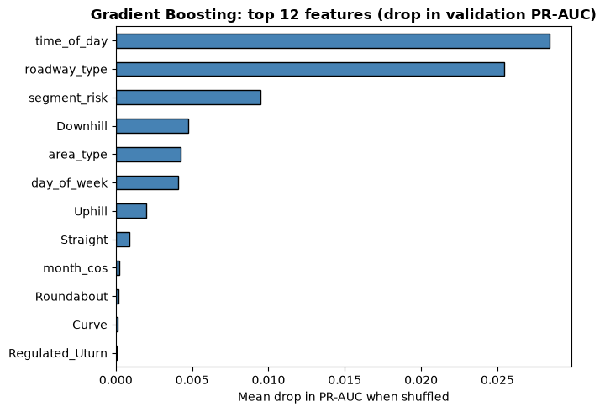
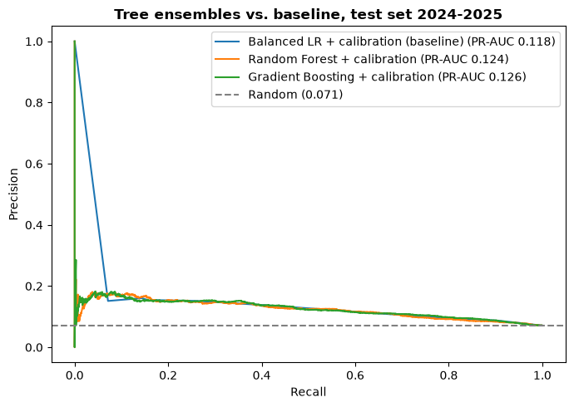
Model 1 — Gradient Boosting (tree ensemble)
04 · PREDICTIVE MODELLING
Histogram Gradient Boosting, compared with a Random Forest; class weights for the 5% fatal rate, no scaling needed.
Why: fatality risk comes from combinations (rural × night × downhill); trees learn these interactions without hand-crafting.
Tuning on validation 2022–23: 13 configs. Small, regularised trees won (lr 0.03, 15 leaves, 150 trees); training on 2015+ only gave no gain.
Validation: PR-AUC 0.134, lift 2.24×. Test 2024–25: PR-AUC 0.126, recall 31.5%, lift 2.10×, Brier 0.064 after sigmoid calibration.
Top drivers: time of day, roadway type, historical segment risk, then downhill, rural area and day of week (matches the EDA).
Road Safety Predictive Analytics — Group 6
20

Slide 21
Model 2 — [Nuno: model name]
04 · PREDICTIVE MODELLING
[To be filled by Nuno]
[Model chosen and why it fits the problem]
[Tuning on validation 2022–2023: what was tried, what was kept]
[Validation results: PR-AUC, recall & lift @ top 15%, Brier after calibration]
[What the model learned: most important features]
Road Safety Predictive Analytics — Group 6
21

Slide 22
Final comparison: test set 2024–2025
04 · PREDICTIVE MODELLING
Model | ROC-AUC | PR-AUC | Recall @ top 15% | Lift @ top 15% | Brier
Dummy (majority class) | 0.500 | 0.071 | 15.0% | 1.00× | 0.071
Balanced LR + calibration | 0.668 | 0.118 | 31.1% | 2.07× | 0.065
Model 1 — Gradient Boosting + calibration | 0.673 | 0.126 | 31.5% | 2.10× | 0.064
Model 2 — [Nuno]
Best so far: Gradient Boosting reaches 31.5% of fatal crashes with 15% of ALS capacity (225 of 715 in 2024–25), 2.1× random, 3 more than the baseline. Small gain: with only road, location and time at t=0, the data limits ranking more than the algorithm. [Nuno: add Model 2 and final winner]
Road Safety Predictive Analytics — Group 6
22

Slide 23
Conclusions
05
What we found, what we'd still need, and what comes next.

Slide 24
Findings, limitations & future work
05 · CONCLUSIONS
Key finding
[After the final models — e.g. best model reaches X% of fatal crashes with 15% of ALS capacity]
Actionable insight
[What dispatch should do — e.g. send ALS to the top-15% risk calls]
Limitations
Reporting change in 2015 (e-DAT) limits older data · GPS only from 2017 and no highway ID, so location is approximate · no traffic, weather or caller information · 150,000-row sample
Future work
Add weather, traffic and caller details at call intake · finer location once GPS covers all years · test training on 2015+ only
Road Safety Predictive Analytics — Group 6
24

Slide 25
Annexes
06
Details for questions, not presented in the 10 minutes.

Slide 26
How historical segment risk avoids leakage
06 · ANNEX
Segment
Highway type × 50-km band × area type (218 segments) — GPS is missing before 2017
Risk
Past fatality rate of the segment, computed on train years 2007–2021 only
Out-of-fold
Each train crash gets the rate from the other 4 folds — it never sees its own label
Smoothing
Small segments are pulled toward the overall train rate (weight of 50 crashes)
Limitation
No highway ID: a segment pools the same km band of all highways of one type
Road Safety Predictive Analytics — Group 6
26

Slide 27
Out-of-time split
06 · ANNEX
Set · years · crashes | Fatal rate
Train · 2007–2021 · 130,870 crashes | 4.49%
Validation · 2022–2023 · 9,073 crashes | 6.97%
Test · 2024–2025 · 10,056 crashes | 7.11%
No random shuffling: models learn from the past and are judged on the most recent years, as they would be used. The higher fatal rate in recent years comes from the 2015 reporting change — handled by calibrating on validation.
Road Safety Predictive Analytics — Group 6
27

Slide 28
Thank you
Questions & discussion
Group 6 · Joao · Olena · Samuel · Nuno · Pedro · Predictive Analytics & Forecasting · EMBAAI

